Slide 1
Predictive Analytics and Dynamic Pricing in the Food and Beverage Industry
Restaurant Management and Data Analytics
Team No 15
Achyuth M(21EG110A01)
M Jayanth(21EG110A27)
P Koushik(22EG510A06)
Under the Guidance of
Mrs. G. Swapna
Assistant Professor
Dept. of Data Science

Slide 2
Overview of the Project
This project develops a data-driven web app for an Indian restaurant using machine learning to optimize operations. It includes:
Demand Forecasting: Predicts weekly menu item demand using decision tree regression for efficient inventory planning.
Dynamic Pricing: Adjusts menu prices based on demand to maximize revenue.
Customer Pattern Analysis: Identifies purchasing trends by demographics for targeted marketing.
Sales & Revenue Forecasting: Provides insights into vegetarian vs. non-vegetarian sales and future revenue projections.
The web app, built with Flask, offers a user-friendly interface displaying all predictions and insights to improve efficiency and drive growth.

Slide 3
Abstract
Objective: Build a machine learning web app to predict weekly food orders, optimize pricing, and analyze customer patterns for better restaurant operations.
Data & Model:
Data: Transaction info (date, demographics, item, order quantity).
Model: Decision Tree Regression.
Preprocessing: Data cleaning, feature engineering, and encoding.
Web Application:
Framework: Flask backend, HTML/CSS frontend.
Features:
Demand forecasting
Dynamic pricing
Customer pattern analysis
Sales insights and revenue forecasting
Deployment: Local web browser, easy to use for managers.
Summary: A user-friendly system for predicting demand, adjusting prices, and analyzing customer behavior through a web interface.

Slide 4
Introduction
The Predictive Analytics and Dynamic Pricing System enhances supply chain management in the food and beverage industry by forecasting food orders, optimizing inventory, and improving customer satisfaction. Using Decision Trees, the system predicts food demand, provides cuisine and category insights, and supports custom scenario predictions. Built with Flask, HTML, and CSS, the user-friendly web app offers data visualization for easy analysis and is deployed locally for seamless access.

Slide 5
Objective
Objective: Develop a machine learning-based food demand forecasting system for efficient inventory management and improved customer satisfaction.
Key Goals:
Accurate Demand Prediction: Forecast food item demand to aid in resource planning.
Optimized Inventory: Minimize overstocking and stockouts, reducing holding costs.
Operational Efficiency: Provide demand insights to streamline operations.
Customer Satisfaction: Ensure timely deliveries and availability of food items.

Slide 6
Existing Work & Limitation
Existing Work:
Traditional Forecasting Methods:
Basic Techniques: Simple models like moving averages and exponential smoothing are commonly used but often fail to capture complex demand patterns.
Manual Inventory Management: Many systems rely on manual processes, which are time-consuming and inefficient, especially for managing large and diverse product portfolios.
Limitations:
Limited Accuracy: Basic forecasting methods often struggle to accurately predict demand due to their inability to model complex, non-linear patterns.
Manual Processes: Dependence on manual input and adjustments leads to inefficiencies and errors in inventory management.
Lack of Scalability: Traditional approaches may not scale well with increasing data volume or evolving market conditions, making them less adaptable to changing demand patterns.

Slide 7
Proposed work
Proposed Work:
Machine Learning Models: Employ advanced models such as Decision Trees for precise demand forecasting.
Predictive Analytics: Analyze patterns, trends, and seasonality to enhance food demand predictions.
Real-Time Updates: Offer real-time forecasts to enable timely adjustments in inventory management.
User-Friendly Interface: Provide an intuitive web interface for easy interaction and visualization of data.
Scalability and Adaptability: Ensure the system adapts to evolving business needs and fluctuating demand patterns.
Integration: Seamlessly connect with existing systems like inventory management and POS for streamlined operations.
Performance Evaluation: Continuously monitor and refine models to improve forecasting accuracy.

Slide 8
Advantages
Advantages:
Enhanced Accuracy: Advanced models capture complex demand patterns for more accurate forecasts.
Efficiency: Automated processes reduce manual effort and improve operational efficiency.
Flexibility: Scalable and adaptable system meets changing business requirements and market conditions.
Real-Time Insights: Immediate updates support proactive inventory management and decision-making.
Seamless Integration: Smooth integration with current systems enhances overall operational coherence.

Slide 9
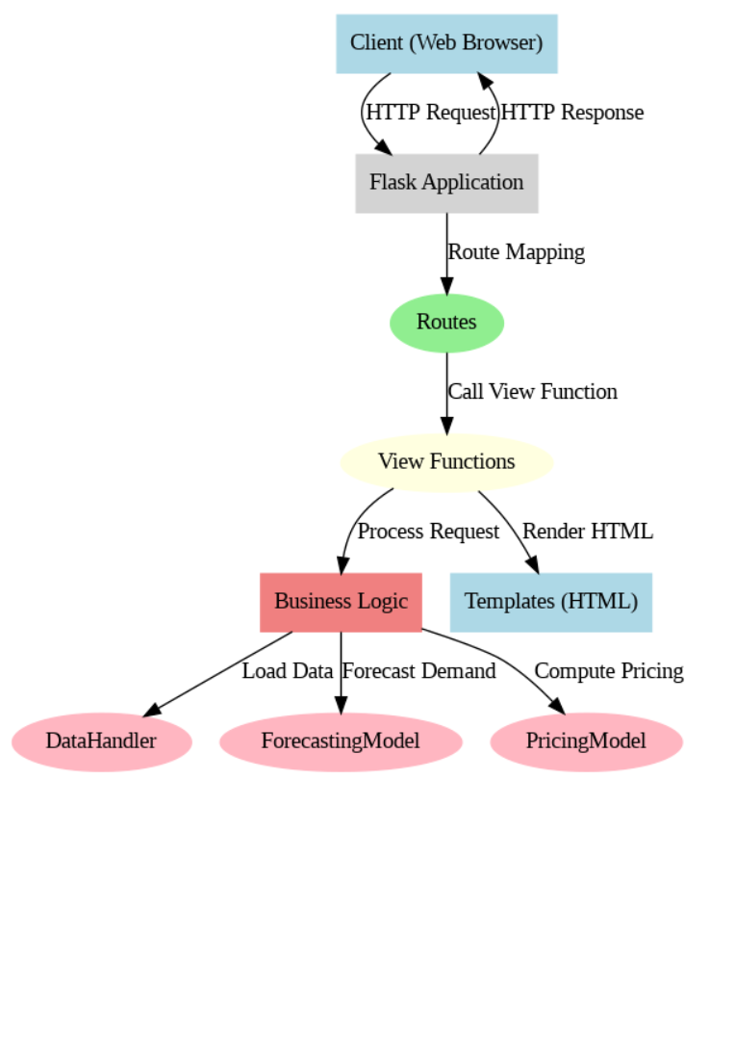
System Architecture

Slide 10
Modules
Data Ingestion and Preprocessing Module
Exploratory Data Analysis (EDA) Module
Demand Forecasting Module
Dynamic Pricing Module
Customer Segmentation Module
Web Application Module
Data Visualization Module
Deployment Module

Slide 11
Modules
Data Ingestion and Preprocessing Module
Tasks:
Loading datasets (restaurant sales, menu, users, orders, etc.)
Data cleaning (handling null values, removing duplicates)
Feature engineering (creating new features, one-hot encoding)
Data merging (combining datasets for analysis)
Data transformation (scaling, normalization)
Exploratory Data Analysis (EDA) Module
Tasks:
Statistical analysis of data
Visualizations (e.g., histograms, bar charts, time series plots)
Identifying trends, patterns, and anomalies
Correlation analysis

Slide 12
Modules
Demand Forecasting Module
Tasks:
Building predictive models (e.g., Decision Trees)
Forecasting weekly demand for each item
Generating demand forecasts for different date ranges
Evaluating model performance (e.g., accuracy, RMSE)
Dynamic Pricing Module
Tasks:
Analyzing historical sales data
Determining optimal pricing based on demand predictions
Implementing dynamic pricing strategies for different items
Displaying suggested prices on the web interface

Slide 13
Modules
Customer Segmentation Module
Tasks:
Analyzing customer data (gender, occupation, purchase history)
Segmenting customers based on purchasing patterns
Identifying target customer groups
Custom predictions based on user-specific scenarios
Web Application Module
Tasks:
Developing the Flask backend
Designing the HTML/CSS frontend
Integrating all functionalities (forecasting, pricing, segmentation)
Creating an intuitive user interface for restaurant managers
Handling user input and displaying results

Slide 14
Modules
Data Visualization Module
Tasks:
Visualizing forecasted demand and order distribution
Generating charts and graphs for stakeholder presentations
Creating interactive visualizations for the web application
Providing visual insights into sales trends and customer behavior
Deployment Module
Tasks:
Setting up a local server for the web application
Ensuring application accessibility through web browsers
Testing and validating the deployment
User interface optimization for ease of use

Slide 15
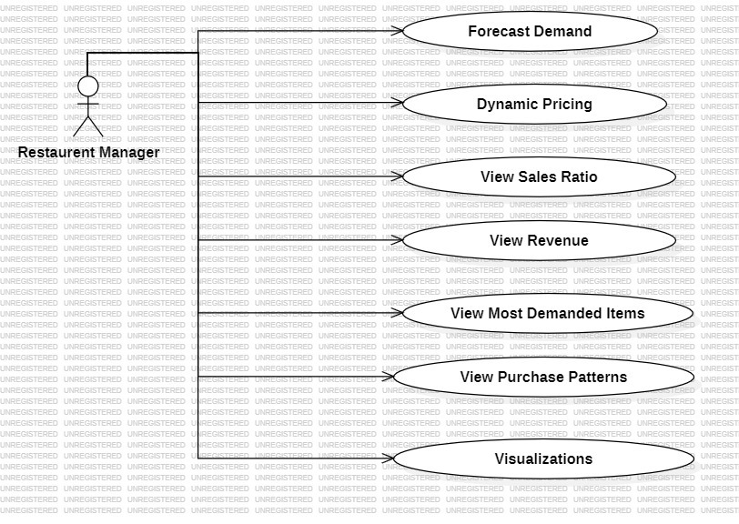
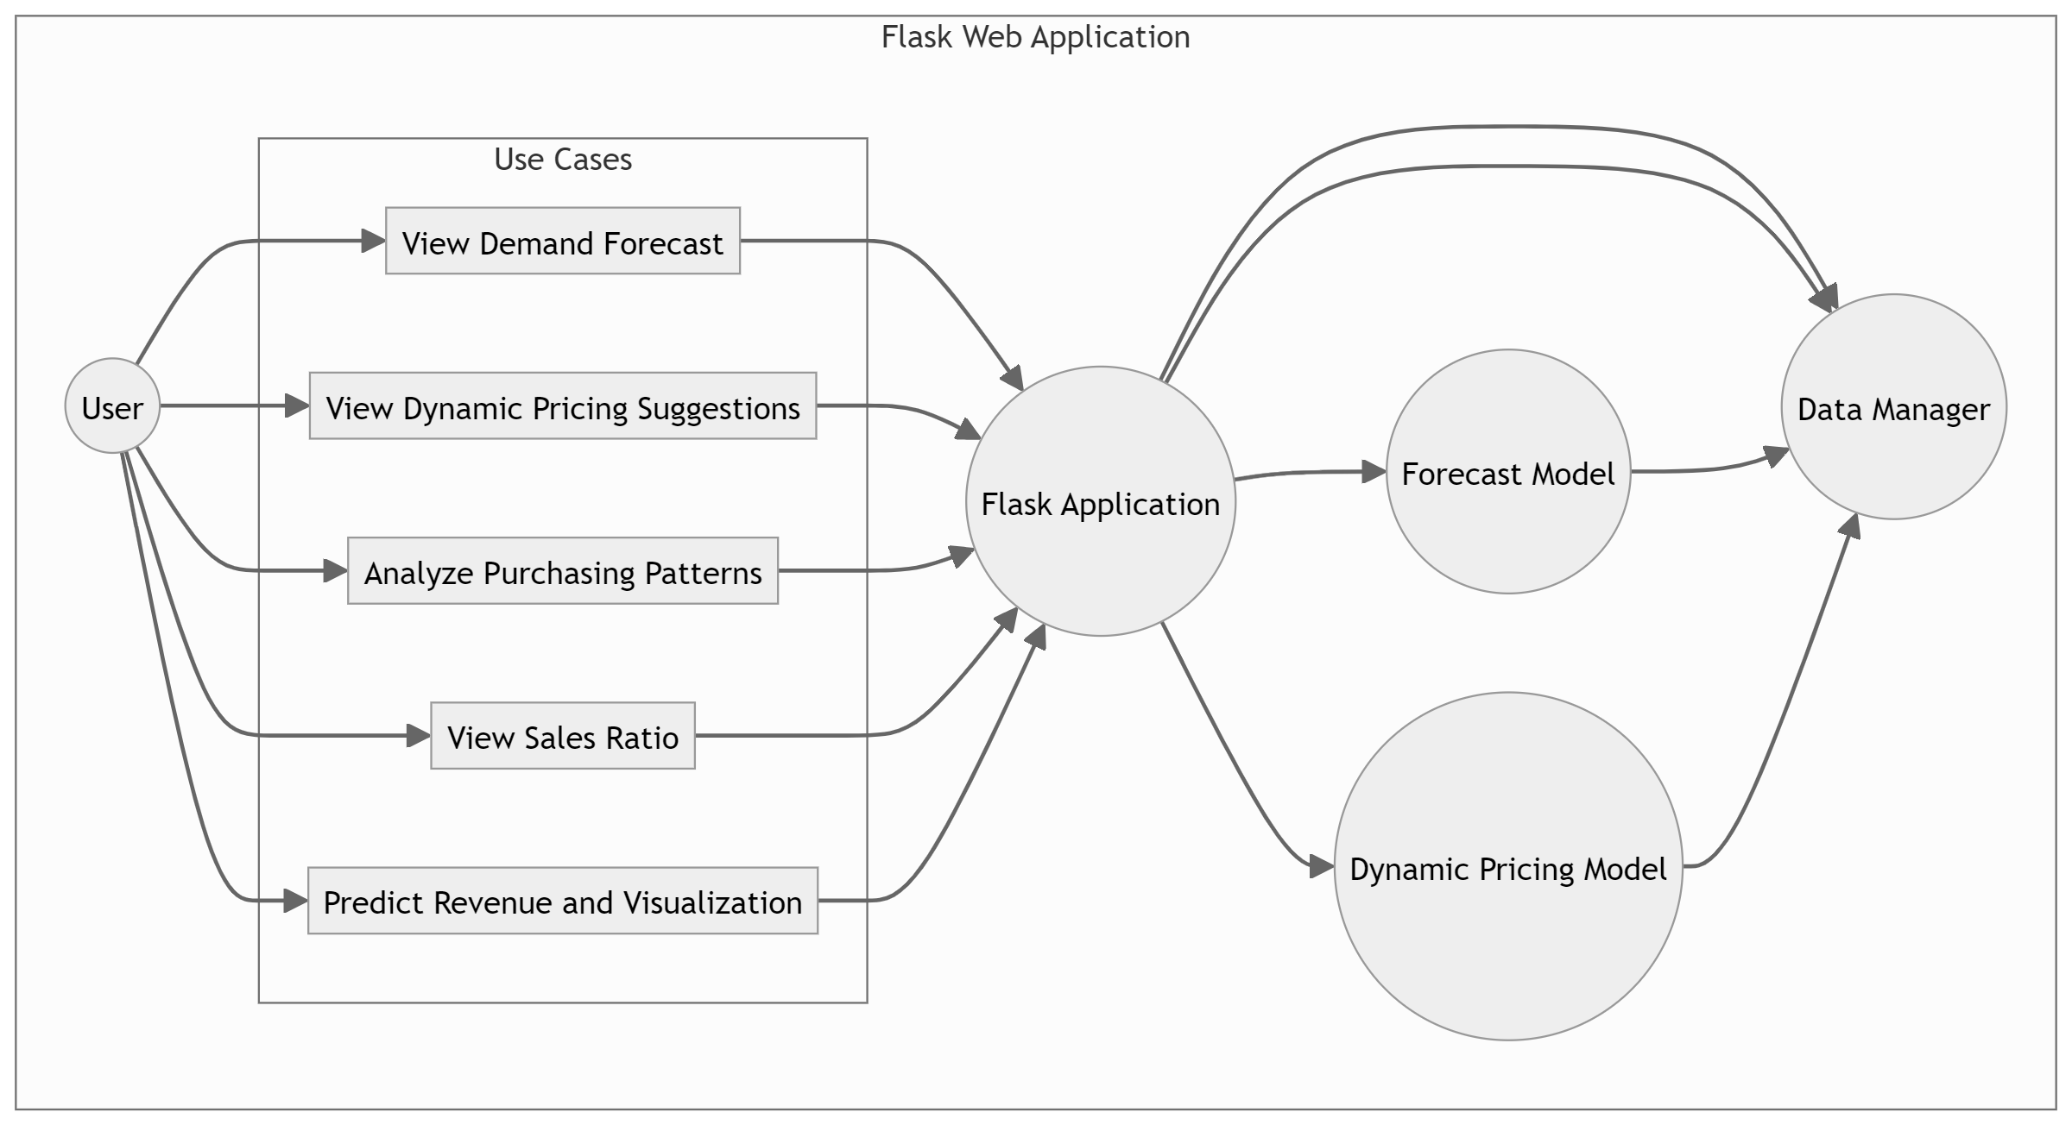
Modules Design

Slide 16
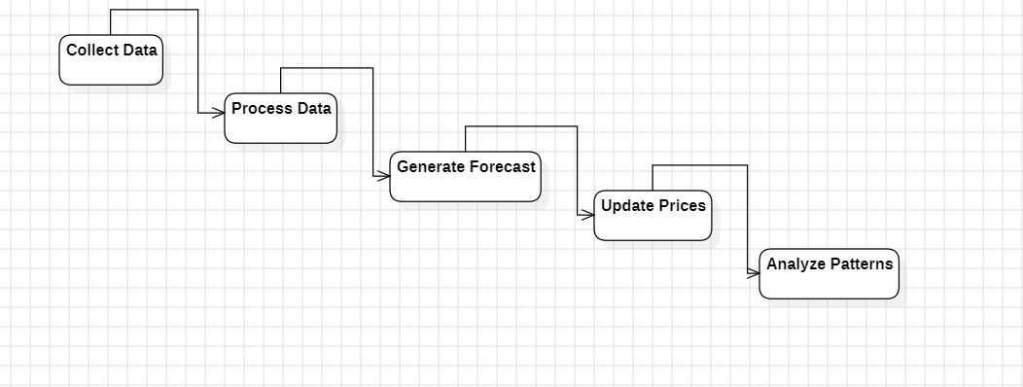
Modules Design

Slide 17
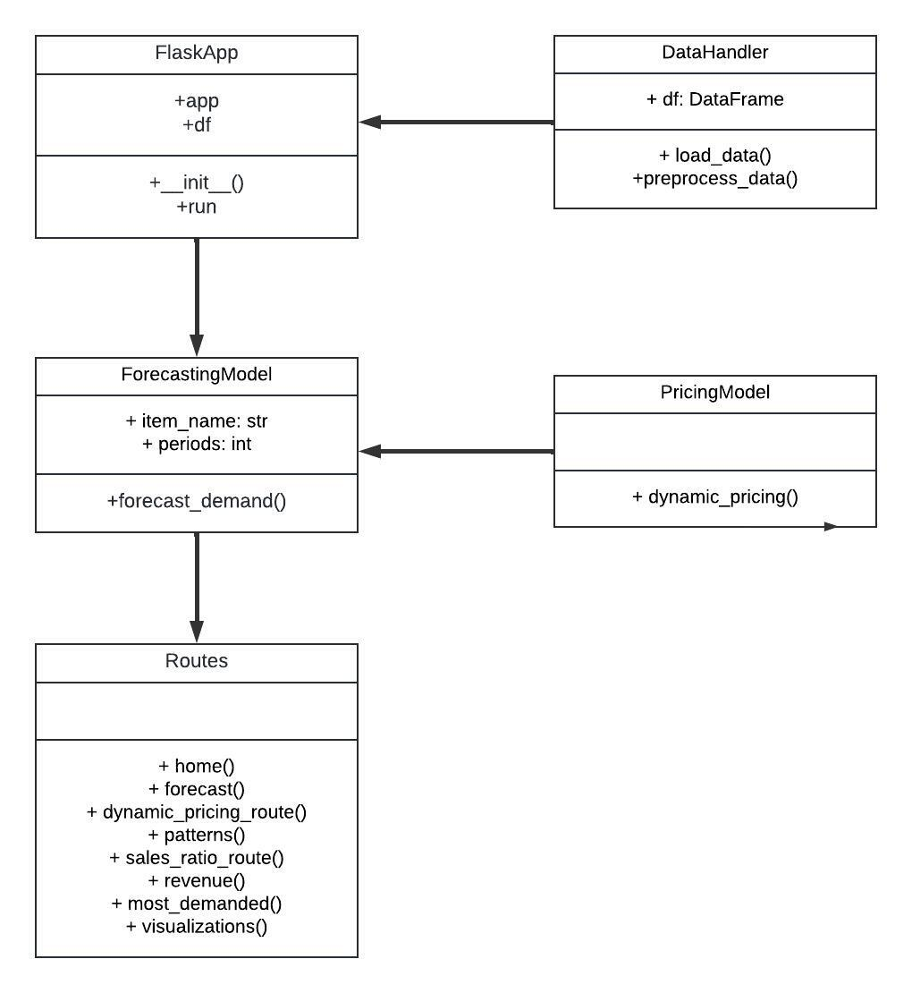
Class Diagram

Slide 18
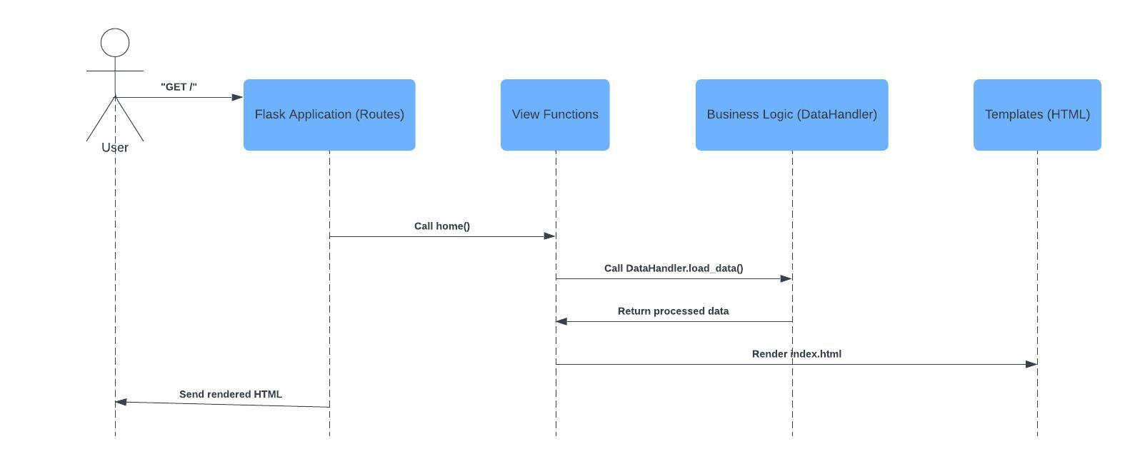
Sequence Diagram

Slide 19
Technologies used
1. Python
2. Flask
3. Pandas
4. NumPy
5. Scikit_learn
6. Jinja2
7. HTML/CSS
8. DateTime

Slide 20
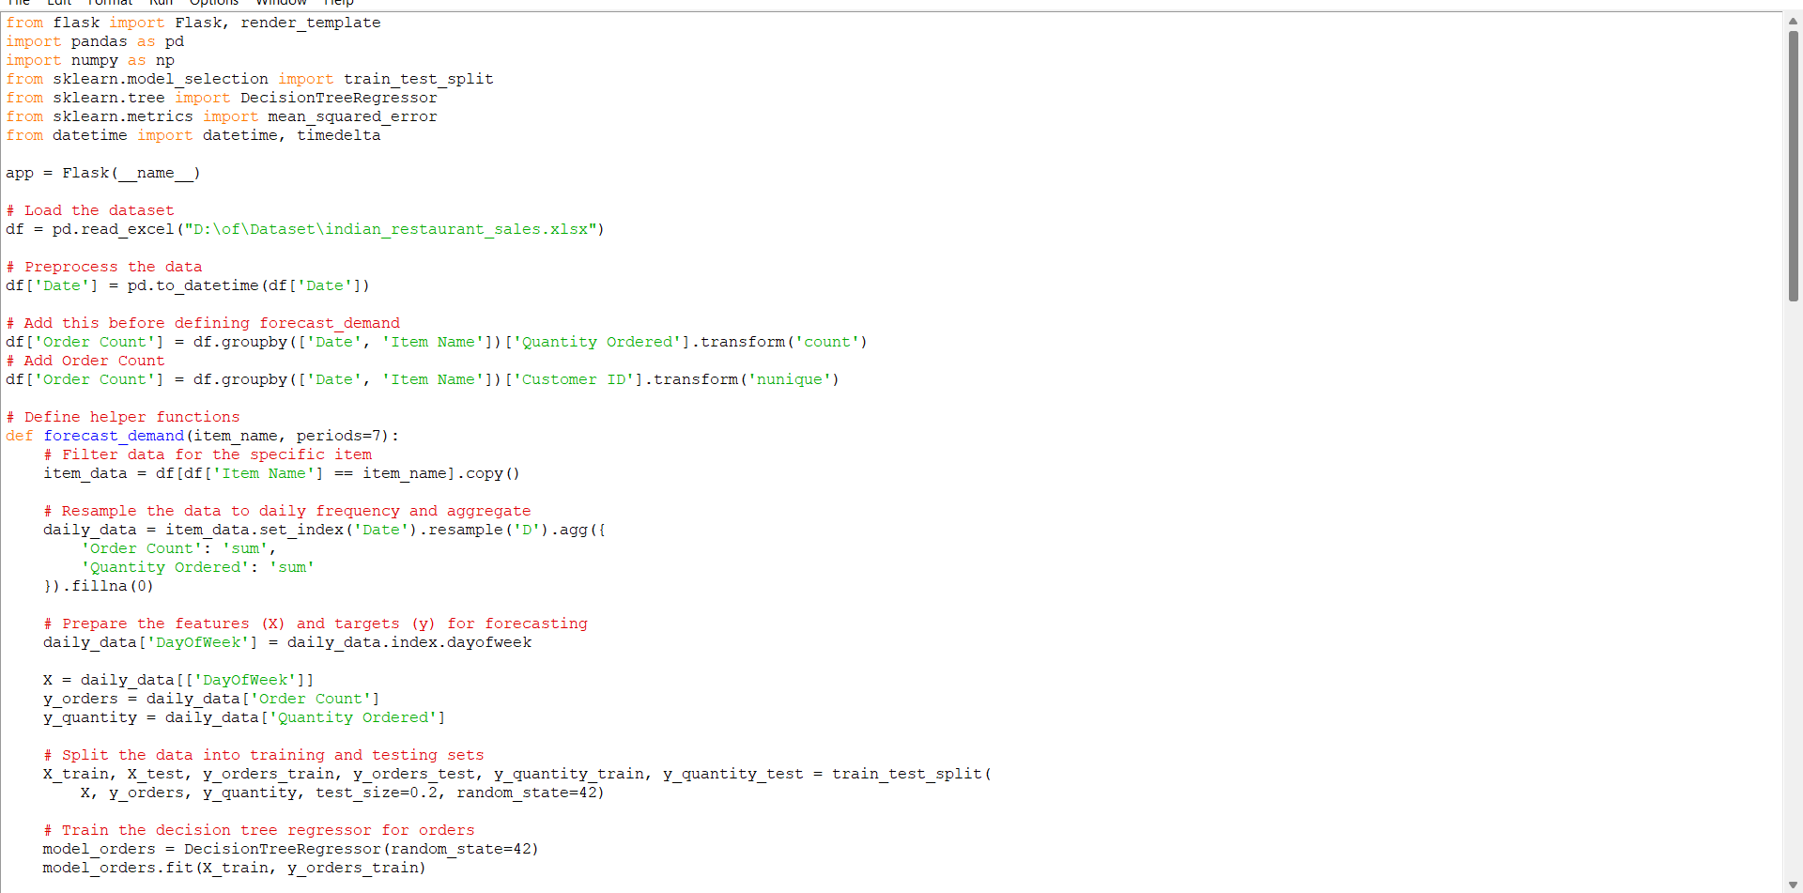
Implementation

Slide 21
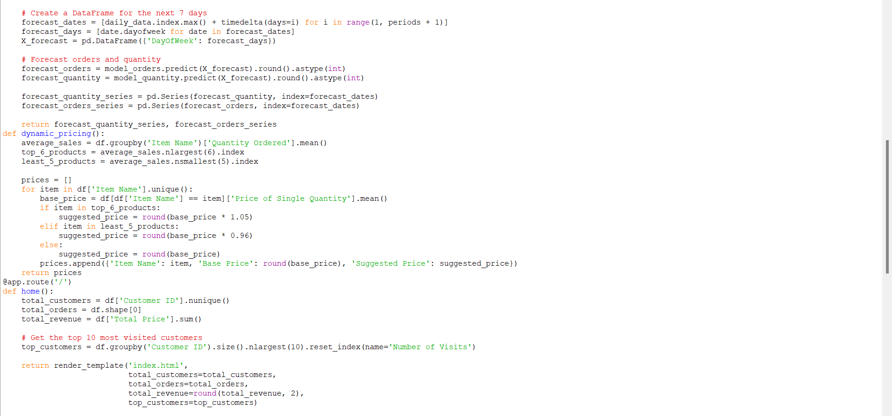
Implementation

Slide 22
Implementation
@app.route('/') def home(): total_customers = df['Customer ID'].nunique() total_orders = df.shape[0] total_revenue = df['Total Price'].sum() # Get the top 10 most visited customers top_customers = df.groupby('Customer ID').size().nlargest(10).reset_index(name='Number of Visits') return render_template('index.html', total_customers=total_customers, total_orders=total_orders, total_revenue=round(total_revenue, 2), top_customers=top_customers) @app.route('/forecast') def forecast(): items = df['Item Name'].unique() forecasts = {} fixed_dates = pd.date_range(start="2024-07-01", end="2024-07-07") for item in items: forecast_quantity, forecast_orders = forecast_demand(item) forecast_data = pd.DataFrame({ 'Date': fixed_dates, 'Forecast Quantity': forecast_quantity.reindex(fixed_dates, method='ffill').fillna(0).astype(int), 'Forecast Orders': forecast_orders.reindex(fixed_dates, method='ffill').fillna(0).astype(int) }) forecasts[item] = forecast_data.values.tolist() return render_template('forecast.html', forecasts=forecasts)

Slide 23
Implementation
@app.route('/dynamic_pricing') def dynamic_pricing_route(): prices = dynamic_pricing() return render_template('dynamic_pricing.html', prices=prices) @app.route('/patterns') def patterns(): patterns = df.groupby(['Gender', 'Customer Occupation', 'Item Name']).size().unstack(fill_value=0).idxmax(axis=1) return render_template('patterns.html', patterns=patterns) @app.route('/sales_ratio') def sales_ratio_route(): veg_sales = df[df['Item Category'] == 'veg']['Total Price'].sum() non_veg_sales = df[df['Item Category'] == 'non-veg']['Total Price'].sum() total_sales = veg_sales + non_veg_sales veg_ratio = round(veg_sales / total_sales, 2) non_veg_ratio = round(non_veg_sales / total_sales, 2) return render_template('sales_ratio.html', veg_ratio=veg_ratio, non_veg_ratio=non_veg_ratio) @app.route('/revenue') def revenue(): total_sales = df.set_index('Date').resample('D').sum()['Total Price'] model = ExponentialSmoothing(total_sales, trend='add', seasonal='add', seasonal_periods=7).fit() revenue_forecast = model.forecast(7) return render_template('revenue.html', revenue_forecast=round(revenue_forecast.sum(), 2))

Slide 24
Implementation
@app.route('/most_demanded') def most_demanded(): # Get the top 5 most demanded food items top_5_demanded_items = df.groupby('Item Name')['Quantity Ordered'].sum().nlargest(5).reset_index() return render_template('most_demanded.html', top_5_demanded_items=top_5_demanded_items) @app.route('/visualizations') def visualizations(): return render_template('visualizations.html') if __name__ == '__main__': app.run(debug=True)

Slide 25
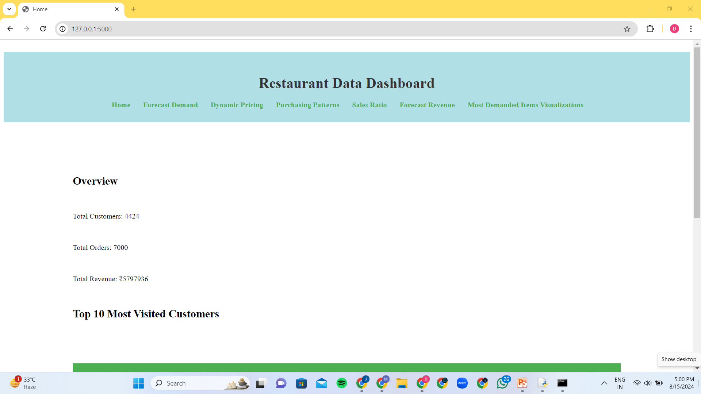
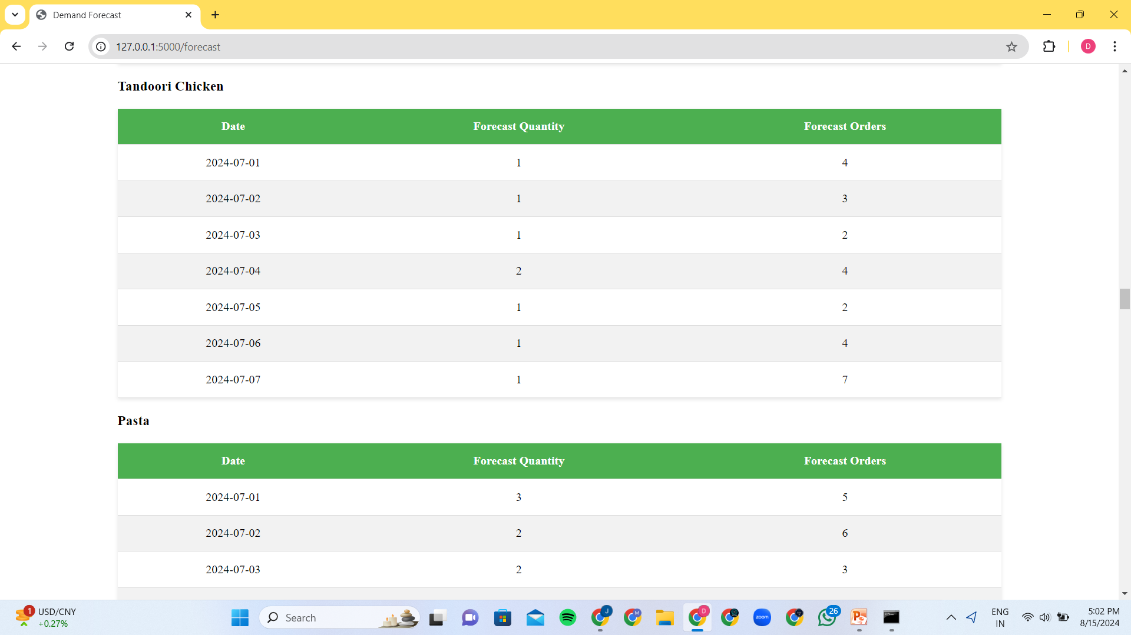
Experimental Results

Slide 26
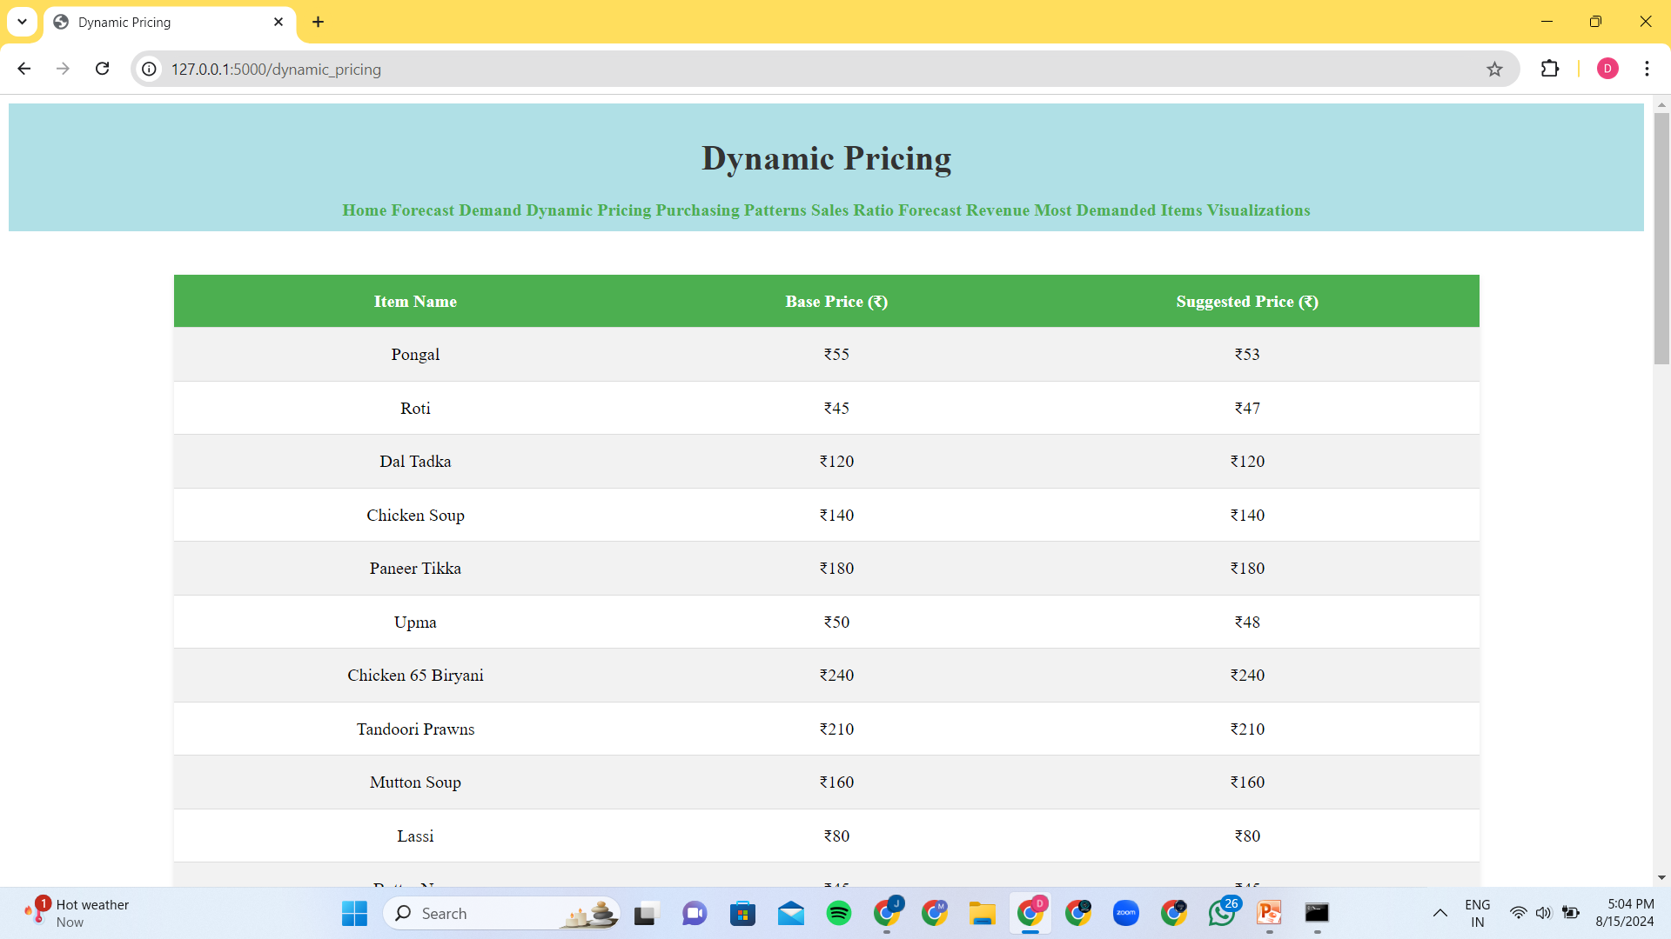
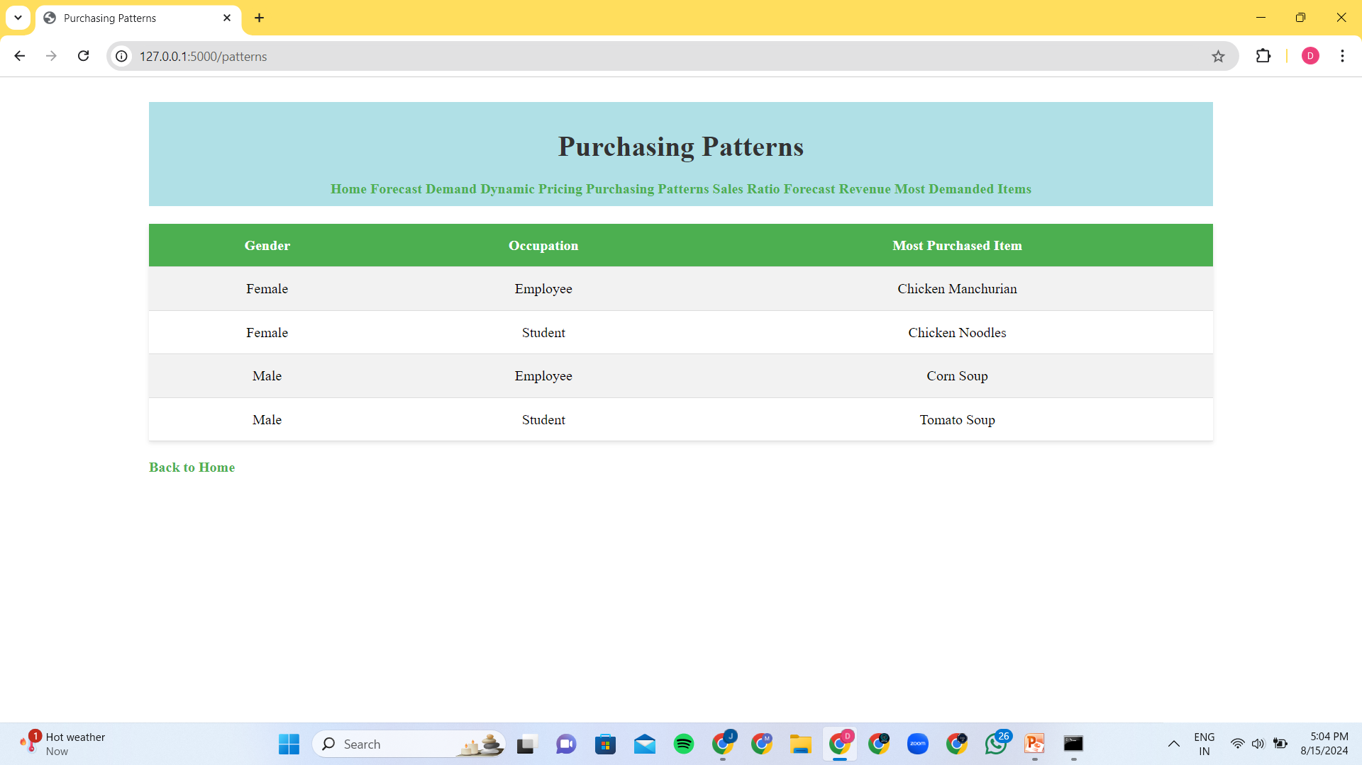
Experimental Results

Slide 27
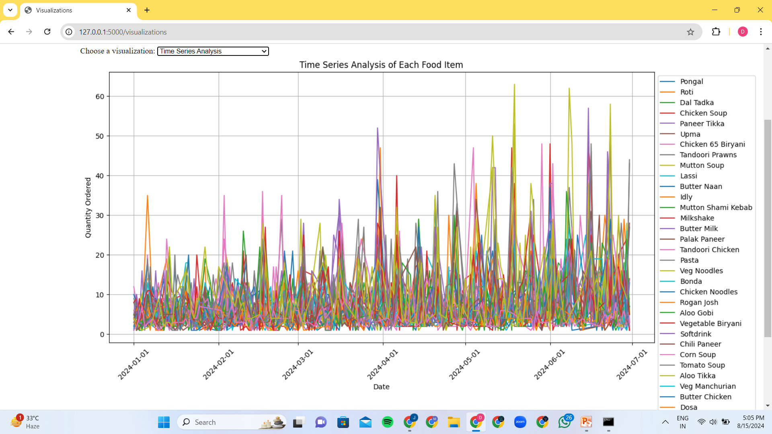
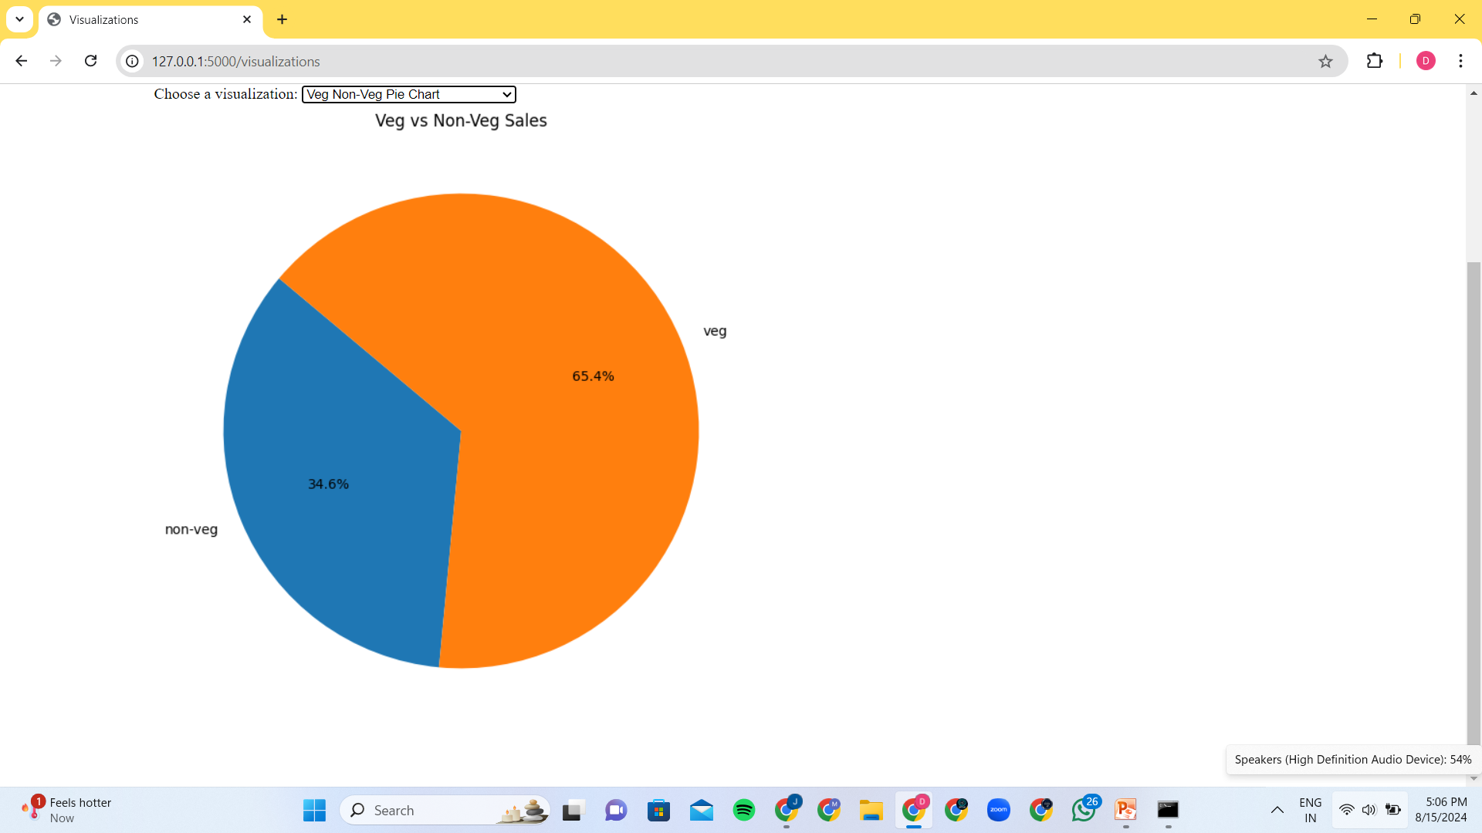
Experimental Results

Slide 28
Conclusion
This project uses machine learning to optimize restaurant operations by predicting weekly food orders, implementing dynamic pricing, and analyzing customer patterns. The web app helps managers make data-driven decisions, improving inventory management, reducing waste, and boosting customer satisfaction. It demonstrates the power of AI to enhance efficiency, anticipate demand, and increase profitability in the food service industry.

Slide 29
References
"Sales Forecasting with Machine Learning: Techniques and Applications" International Journal of Forecasting
"Hands-On Machine Learning with Scikit-Learn, Keras, and TensorFlow" by Aurélien Géron
“Demand forecasting to improve customer loyalty and margins while minimizing food loss
”cropin

Slide 30
Thank you

